Slide 1
W-2: Huebner Creek – Eckhert to Bandera
Patrick O’Connor, PE
Project Engineer, SAWS
Roxanne L. Lockhart
Contract Administrator, SAWS
Marisol V. Robles
SMWVB Program Manager, SAWS
Ryan Sowa, PE
Project Engineer of Record, Kimley-Horn & Associates
Non-Mandatory Pre-Proposal Meeting
April 7, 2021 at 9:30 AM

Slide 2
WebEx Meeting Information
With the switch to an online WebEx meeting, attendees can:
  Access the presentation thru the WebEx link to follow along real-time
  Access via phone and follow along with the PowerPoint posted on the SAWS web at: https://apps.saws.org/business_center/contractsol/Drill.cfm?id=3865&View=Yes
  Use the chat feature to ask questions, or
  Ask questions through email to roxanne.lockhart@saws.org
    SAWS will read questions aloud
Please mute your devices during the meeting

Slide 3
Oral Statements
Oral statements or discussion during the pre-proposal meeting will not be binding, nor will it change or affect the terms or conditions within the Plans and Specifications for this Project. Changes, if any, will be addressed only via an Addendum.

Slide 4
Meeting Agenda
Project Overview
Key Project Information
Contract Requirements
Evaluation Process
Required Experience
Evaluation Criteria
SMWB
Proposal Packet Preparation
Additional and Communication Reminders
Key Dates
Key Dates
Submission Due Date
Contract Background
Contract Requirements
  Supplemental Conditions
  Special Conditions
  Special Provisions
  Special Specifications
  Additional Project Details
Questions

Slide 5
Project Overview
Upsizing approximately 2 miles of 21-inch and 24-inch sewer mains with 24-, 36-, and 42-inch gravity sanitary sewer pipelines.
Installation of large diameter sewer at depths of up to 25 ft
Installation of sewer within the 100-yr floodplain
Narrow construction corridor, along Huebner Creek
Existing utilities that must remain in service
Bypass pumping for large and small sewer lines within the 100-yr floodplain
Coordination with CoSA, SARA, and City of Leon Valley

Slide 6
Key Project Information
Contract duration is 450 calendar days
Construction cost estimate is approximately $14,740,000.00
Procured under Chapter 2269 of Texas Government Code as a Request for Competitive Sealed Proposals (RFCSP)
EPA Consent Decree project, which requires additional reporting and retention of document (see Special Conditions)

Slide 7
Contract Requirements
  Prevailing Wage Rate and Labor Standards – Section 2.10 of the General Conditions
  Certified payroll to be submitted on weekly basis
  Wage decisions are included within the specifications
  Contractors to utilize LCP Tracker
  Site visits are random and unannounced
  Interviews will be conducted and will be private & confidential
  Payroll records are subject to review
  All apprenticeship programs will need to be approved by Department of Labor prior to starting
  Contractors are responsible for sub-contractor payroll
  Late payrolls delay contractor payments from SAWS

Slide 8
Contract Requirements
Insurance – Found in Section 5.7 of the General Conditions
  Include General Liability for Construction, Pollution Liability, Excess Liability and Installation Floater (in lieu of Builder’s Risk).
  Selected contractor must be compliant with all other contracts in order for SAWS to award the contract.
  SAWS will request insurance certificate prior to Board award to ensure insurance compliance and expedite execution of the contract.
  Insurance must be compliant prior to executing the contract.

Slide 9
Evaluation Process
  Technical Evaluation Committee (TEC) will score the proposals based on the evaluation criteria published in the Supplementary Instructions to Respondents to determine the Respondent who can provide the best value to SAWS
  Price will be calculated (lowest price receives the highest points) and added to final scores
  SMWB will be added to final scores
  Selection Evaluation Committee reviews final scores
  Negotiations, if any
  Board award

Slide 10
Required Experience
Respondents submitting a proposal for this RFCSP should demonstrate, completely and sufficiently, that large diameter wastewater pipeline installations are a primary business focus and service, and such services have been successfully provided for at least five (5)continuous years.

Slide 11
Evaluation Criteria
Criteria | Weight | Pg. No.
Team Qualifications and Experience | 15% | SIR-3
Quality, Reputation, and Ability to Deliver Projects on Schedule and within Budget | 25% | SIR-5
Project Approach including Delivery Schedule | 15% | SIR-8
Price Proposal | 35% | SIR-9
Small, Minority, and Woman-owned Business Participation | 10% | SIR-10
TOTAL | 100%

Slide 12
Evaluation Criteria
Team Qualifications and Experience (15 points)
Organizational Structure and Key Information on Prime Contractor
  Company information (structure, debarment history, # of employees, years of construction work, etc.)
  Organizational Chart with Key Personnel with percentage of availability, clear description of roles and responsibilities (Prime and Key Subs)
    Team history or approach if no prior experience to ensure successful completion of project
  Contractor CANNOT change Key Personnel identified in proposal without written request to SAWS and SAWS written approval
  Financial statement for the most recent 3 complete fiscal years

Slide 13
Evaluation Criteria
Team Qualifications and Experience
Qualifications and Experience of Key Personnel Proposed for Project
  Resumes of Key Personnel on 8 ½ x 11” one per person, not to exceed one (1) page as identified on the Org Chart
    Professional experience, education, role, descriptions of capabilities, etc.
    List of all other active projects team member assigned, percentage, date of completion of work
✓ Key Personnel include PM, Construction Manager, QA/QC Lead, Project Scheduler, Project Superintendent, Open Cut Superintendent, Microtunneling Superintendent, and Pipe Jacking/ Tunneling Superintendent.
✓Key Subcontractor roles could include tunneling, hand mining, large diameter open cut, sewer bypass.

Slide 14
Evaluation Criteria
Quality, Reputation and Ability to Deliver Projects on Schedule and within Budget (25 points)
Prime Contractor Performance on Similar Projects in the past 10 years
  List and describe 5 completed projects of similar size, scope, and complexity within the last 10 years
  Owner reference contact information should be valid and recently verified
    If valid contact information is not provided, score or proposal may be negatively impacted
  2 of the 5 projects listed must have been performed by the proposed Key Personnel
  If SAWS experience, one project of similar size, scope, and complexity must be included
  The Respondent shall provide information for all current and recently completed large diameter pipeline projects performed in the last five (5) years for all Utility Owners in Texas

Slide 15
Evaluation Criteria
Quality, Reputation and Ability to Deliver Projects on Schedule and within Budget
Key Subcontractor(s) Performance on Similar Projects in the Last 10 years
  Provide list of 2 projects that Key Subcontractors Project Manager and/or Superintendent participated in of similar size, scope, and complexity
  If Prime plans to self-perform and has no Key Subcontractors, provide a list of 2 additional projects
    Key Personnel shall have participated in at least 1 of the 2 projects

Slide 16
Evaluation Criteria
Project Approach including Delivery Schedule (15 points)
Project Approach
  Narrative of Project Approach to complete project, including key milestones, critical path items, phases and/or sequencing, permits, etc.
  Availability of equipment and facilities
  Describe approach for coordination with key stakeholders
  Provide innovative ideas for cost savings (due to a change in scope)
    Opportunity to provide innovation (per TX Gov’t Code 2269)
    Providing initial price, based on provided Contract Documents
    Negotiation can/will take place with best value Contractor
  Quality Management Plan including subcontractor oversight, QA/QC, etc.

Slide 17
Evaluation Criteria
Project Approach including Delivery Schedule
Project Schedule, Procurement of Long-lead Items, & Unforeseen Conditions
  Critical path method (CPM) schedule Primavera or Microsoft project - Assume NTP of July 26, 2021.
  Describe the approach to procure long-lead items
  List and describe prior instances of unforeseen conditions
  Approach for mitigating and managing unforeseen conditions on this project

Slide 18
Evaluation Criteria
Safety Information for Prime Contractor and Key Subcontractor(s)
Records showing Total Recordable Incident Rate (TRIR) past 5 years for Prime Contractor and Key Subcontractor(s)
Provide records showing the company’s Experience Modification Rate (EMR) past 3 years for Prime Contractor and Key Subcontractor(s)
List fatalities in company’s safety history for Prime Contractor and Key Subcontractor(s)

Slide 19
Evaluation Criteria
Price (35 points)
Lowest total price will receive 35 points.
Remaining proposals will receive points based on comparison to the lowest price proposal.
Small Minority, and Woman-owned Business (10 points)
Up to 10 points may be earned for SMWB participation as indicated on SIR-10 and SIR-11.

Slide 20
Evaluation Criteria
Industry | Aspirational SMWB Goal
Construction | 20%
The aspirational SMWB goal is expressed as 20% of your total bid price.

Slide 21
SMWVB Scoring
Proposed SAWS Construction Alternative Delivery Method SMWB Scoring:
All respondents may earn the maximum number of SMWB points (10 points). Firms may use any combination of points below when attempting to meet the SMWB goals. Self-performance and subcontracting may be used to achieve the aspirational goals and earn points. SMWB prime contractors and/or subcontractors must be certified by the South Central Texas Regional Certification Agency, and must have a local presence in the San Antonio Metropolitan Statistical Area in order to be eligible for SMWB points.
1. M/WBE Scoring Method: 10 Points (By percentage) 20.00% M/WBE Goal
• MBE Participation Percentage between 1% and 4.99%: 1 Point
• MBE Participation Percentage between 5% and 9.99%: 2 Points
• MBE Participation Percentage between 10% and 14.99%: 4 Points
• MBE Participation Percentage between 15% and 16.99%: 5 Points
• MBE Participation Percentage between 17% and 19.99%: 8 Points
• MBE Participation Percentage meeting or exceeding 20.00%: 10 Points
2. SBE (Non-M/WBE) Scoring Method: 5 Points (By percentage) 5% SBE Goal
• SBE Participation Percentage between 1% and 1.99%: 1 Point
• SBE Participation Percentage between 2% and 2.99%: 2 Points
• SBE Participation Percentage between 3% and 3.99%: 3 Points
• SBE Participation Percentage between 4% and 4.99%: 4 Points
• SBE Participation Percentage meeting or exceeding 5.00%: 5 Points

Slide 22
Accepted SMWVB Certification Agency
South Central Texas Regional Certification Agency
(Includes the Texas Historically Underutilized Business “HUB” Program)
Minimum Qualifications for SMWVB recognition:
SBE-Certified (even MBEs and WBEs)
Local office or local equipment yard

Slide 23
Good Faith Effort Plan (GFEP) FAQs
Q: Is the 20% SMWVB goal mandatory?
A: No, but we ask prime contractors to do their best with good faith outreach efforts. If the goal is not met, proof of outreach efforts is required with the submittal.
Q: What if I am having trouble finding SMWVB subcontractors?
A: Please email the SMWVB Program Manager with the scopes of work you are seeking. You will receive lists of local SMWVB-certified firms to contact.
Q: What if my business is SMWVB-certified? Do I need to find SMWVB subs?
A: If your firm is SMWVB-certified, you will most likely meet the goal. However, the GFEP is a required document, and a good faith outreach effort is still necessary.
Q: Do I need to include all my subcontractors in the GFEP or just those that qualify towards the
SMWVB goal?
A: All subcontractors need to be included in the GFEP, even those that may not count towards the SMWVB goal.
Q: What if I have questions about the GFEP?
A: Please contact the SMWVB Program Manager at 210-233-3420, or at Marisol.Robles@saws.org . GFEP questions can be asked at any time before the submittal is due.
Notes:
SMWB

Slide 24
Post Award: Subcontractor Payment & Utilization Reporting (S.P.U.R.) System
1. Subcontractor & Supplier Payment Tracking
2. Subcontractor and Supplier Additions or Substitutions
3. LCP Tracker
4. Must be Current and Accurate before Retainage is released https://saws.smwbe.com

Slide 25
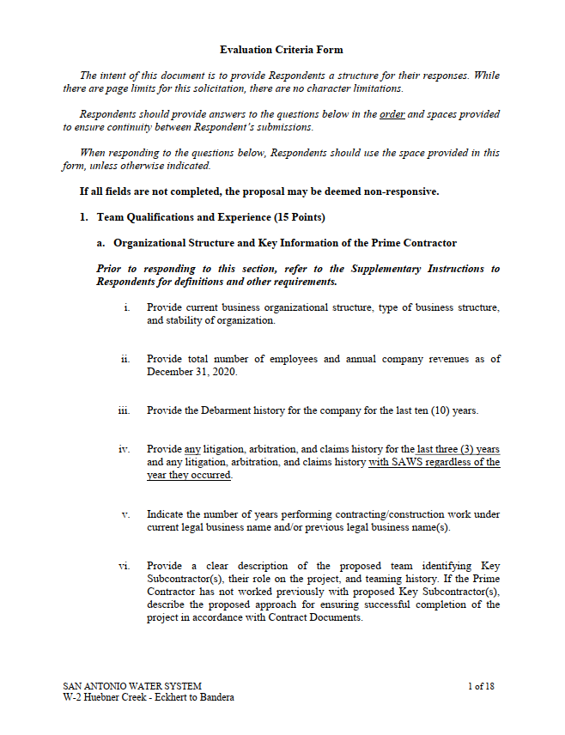
Proposal Packet Preparation
Request FTP Site for proposal upload
Proposal page limits do apply ; see Required Documents Matrix
Review Instructions to Respondents and Supplementary Instructions to Respondents
Utilize the Proposal Response Checklist
  3 files required for electronic submittal with different information
  Follow file naming convention
Utilize Provided Evaluation Criteria Forms
  Fillable form in Word is provided on SAWS website

Slide 26
Proposal Packet Preparation
Required Experience within the proposal should:
  Create a clear picture of Project Team experience and capabilities (Org chart, projects, and resumes for Key Personnel and Key Subcontractors)
  Show large diameter wastewater pipe installation is primary business focus and service, such services successful for at a minimum of 5 continuous years.
Thoroughly review scope and ensure project examples and key personnel resumes clearly show similar experience
Thoroughly review evaluation criteria and respond with all required information to maximize points
Avoid “boilerplate” responses

Slide 27
Proposal Packet Preparation
Verify contact information for all project references, if SAWS is not able to contact reference, points may be deducted or proposal deemed non-responsive
Ensure required documents are submitted and signed (i.e. Respondent Questionnaire, CIQ, etc.)
Price Proposal
  Acknowledge Addendums on Proposal Signature Page
  Verify all formula extensions and mob and prep of ROW percentages

Slide 28
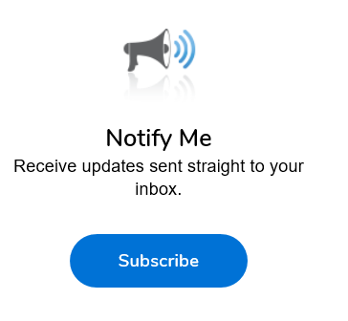
Additional Reminders
Register with Vendor Registration Program on the SAWS website at www.saws.org to ensure access to the latest information.
To receive updates on specific projects, registered vendors should subscribe to the project by selecting the project, and clicking ‘Subscribe’ under the Notify Me box.
Notes:
Contracting

Slide 29
Communication Reminders
There shall not be any communication with the following during the Proposal period:
  Design Engineer (Kimley-Horn & Associates)
  SAWS Project Manager or Project Engineer
  Any other SAWS staff
  City Council member or staff
  SAWS Board of Trustees
This includes phone calls, emails, letters, or any direct or indirect discussion of the Proposal

Slide 30
Key Dates
April 7, 2021 Non-Mandatory Pre-Proposal Meeting
April 14, 2021 by 4:00 PM Questions Due
April 21, 2021 by 2:00 PM Addendum Posted to SAWS Website
May 6, 2021 by 2:00 PM Last chance to request FTP Site
May 7, 2021 by 2:00 PM Proposals Due
May 2021 Proposals Evaluated
May / June 2021 Selected Contractor Notified
July 13, 2021 SAWS Board Approval and Award
July 26, 2021 NTP Issued
Notes:
Please note that the last chance to request a secure FTP Site is Oct. 2, 2020 at 2pm. This FTP site will be required to upload proposals…

Slide 31
Submission Due Date
Proposals due no later than 2:00 PM CDT May 7, 2021
Electronic Proposals Only
Follow specific electronic proposal delivery instructions:
  Request the FTP Site for Upload no later than May 6, 2021 at 2:00 PM
  Follow naming convention provided in the Respondent Proposal Checklist for all 3 files
  Late responses will not be accepted and will be not be opened
  A WebEx proposal opening meeting will be held May 7, 2021 at 2:00 PM
SAWS continues to monitor and adhere to the current COVID-19 guidelines and may modify the proposal submission instructions.
  If so, this would be provided via Addendum no later than April 21, 2021.

Slide 32
Contract Background
Submittals can be submitted as soon as receiving notification of contract award after CPMS training (if necessary) has been completed and CPMS record is ready
Prior to commencing work, contractor must submit and receive approval of the following:
  Construction Schedule
  Pre-construction video
  Lease agreements
There will be one pre-construction meeting
Contractor must submit a Work Progress Schedule within 10 days of NTP and monthly thereafter

Slide 33
Contract Background
Contractor to follow requirements identified in corresponding permits or agreements.
  City of San Antonio Tree Permit
  City of San Antonio and City of Leon Valley Floodplain Development Permit
  City of San Antonio and City of Leon Valley Right-of-Way
  Storm Water Pollution Prevention Plan (SWPPP)
Changes in field that are cited by the Agency’s Inspector will require concurrence and approval from the SAWS Inspector first.
If contractor would like to work weekends or extended hours, notification is required 48 hours in advance to SAWS Construction and Inspections. Requests should be send to constworkreq@saws.org.

Slide 34
Contract Background
All RFIs, RFPs, submittals, and any other items related to construction must be uploaded and processed via CPMS.
No work can be performed by the Contractor unless the cost for that line item is on the contract.
All traffic control plans must be submitted to and approved by CoSA as applicable.
Change orders, if any, will be based on negotiated prices if items are not in the price proposal.
  Negotiated using RS Means

Slide 35
Contract Requirements
Supplemental Conditions
Liquidated damages (LDs) for final completion extending beyond contract time will be assessed at a rate of: $ 1,300.00 per Day
Contractor shall perform Work with its own organization on at least 40% of the total original contract price to be confirmed by Respondent on Pg. 1 of the Good Faith Effort Plan.
ID Key Personnel, to be issued in Addendum 1
Baseline Schedule, to be issued in Addendum 1
Special Construction Conditions
  City of Leon Valley Natural Area and Raymond Rimkus Park
  Northwest Little League of San Antonio, Inc.
  T-Post As Easement Boundary Markers
  Crossing Recycle Water Mains

Slide 36
Contract Requirements
Special Provisions
SP 100 – Mobilization: Establishes Intermediate Demobilization and Remobilization bid item if elected by SAWS, including definition of related temporary bypass pumping activities during SAWS-authorized demobilizations.
SP 540 – Temporary Erosion, Sedimentation, and Water Pollution Prevention Control: Contractor shall prepare and submit SWPPP documents designed and sealed by either PE, CPESC, or LA.
SP 804 – Excavation, Trenching and Backfill: Maximum length of open trench shall not exceed 400 feet.

Slide 37
Contract Requirements
Special Provisions
SP 820 – Concrete Steel Cylinder Pipe: Contractor to confirm CSC pipe joints at open cut sewer crossing are welded and if determined the joints are not welded, the Contractor shall weld the CSC pipe joint.
SP 848 & SP 857 – Payment for installation of pipe (LF) and separate pay item for testing (LF).
SP 849, 850, 852, 856, 866: Full Specification Replacements
SP 853 – Glass-Fiber Reinforced Polyester (FRP) Manholes: Payment for installation of manholes (EA) and separate pay item for testing (EA)

Slide 38
Contract Requirements
Special Provisions
SP 857 – Fiberglass Reinforced Pipe for Large Diameter Gravity Sanitary Sewer: Payment for installation of manholes (LF) and separate pay item for testing (LF)
SP 862 – Abandonment of Sewer Mains and Manholes: Payment for sewer line abandonment is per linear foot complete in place.

Slide 39
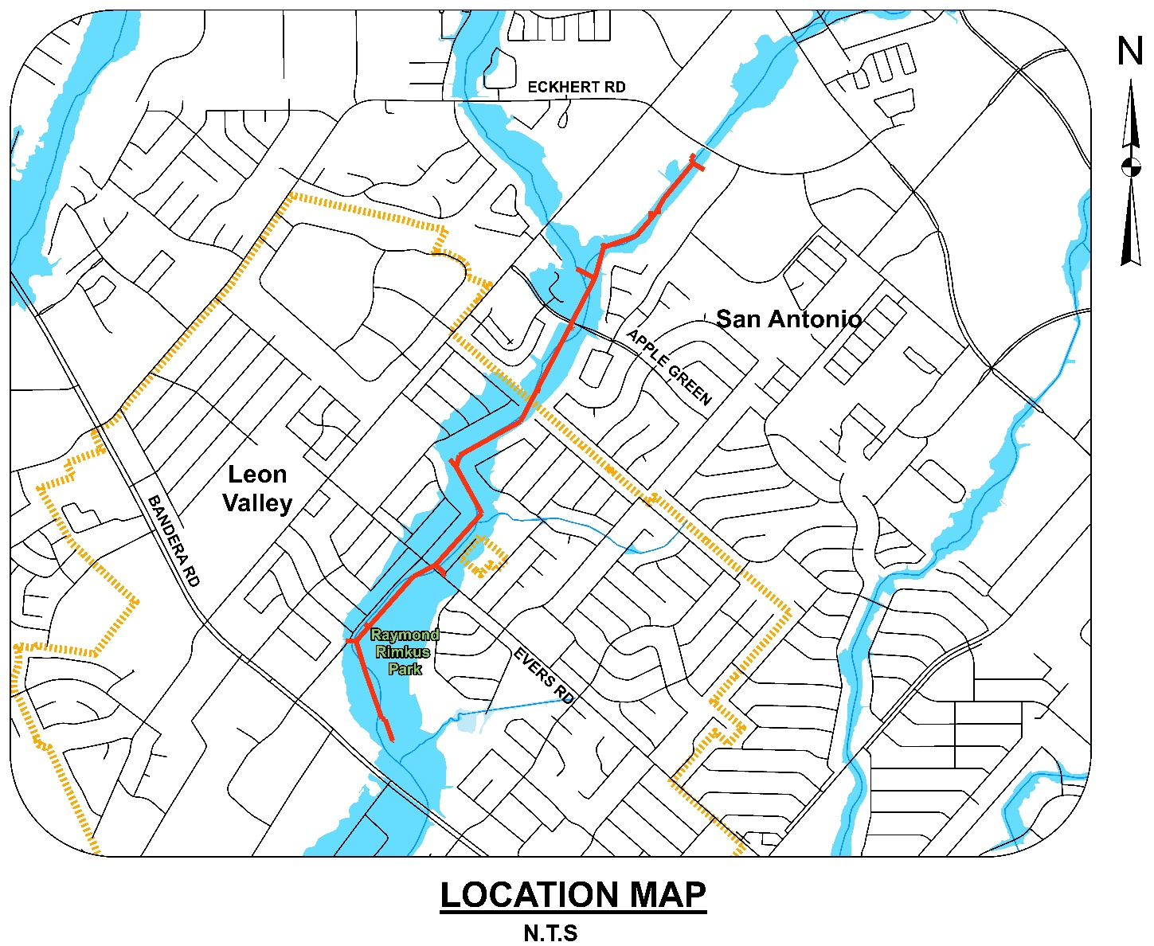
Project Overview
Approximately 10,400 LF 24-, 36-, and 42-inch Gravity Sanitary Sewer Pipeline
Along Huebner Creek (Eckhert to Bandera) – All in Floodway
Project limits are within CoSA and CoLV jurisdiction
Several tunneled sections within the CoLV near Raymond Rimkus Park and Leon Valley Natural Area

Slide 40
Project Details
Large Diameter Tunneling – The alignment includes multiple tunneled segments. The lengths and sizes of these trenchless runs range from ~90 to 900 feet for 54- and 60-inch casing, totaling more than 3,000 linear feet.
Sanitary Sewer Bypass Pumping – Bypass pumping is needed at multiple locations along the alignment, with flows as high as 7 million gallons per day (MGD). Bypass pumping to occur within 100-year floodplain.
Existing Utility Crossings – The alignment will cross beneath multiple significant utilities, including an existing 24-inch sewer main and 36-inch recycle water main in several locations. Submittals required to identify proposed methods of support and bracing of existing utilities.

Slide 41
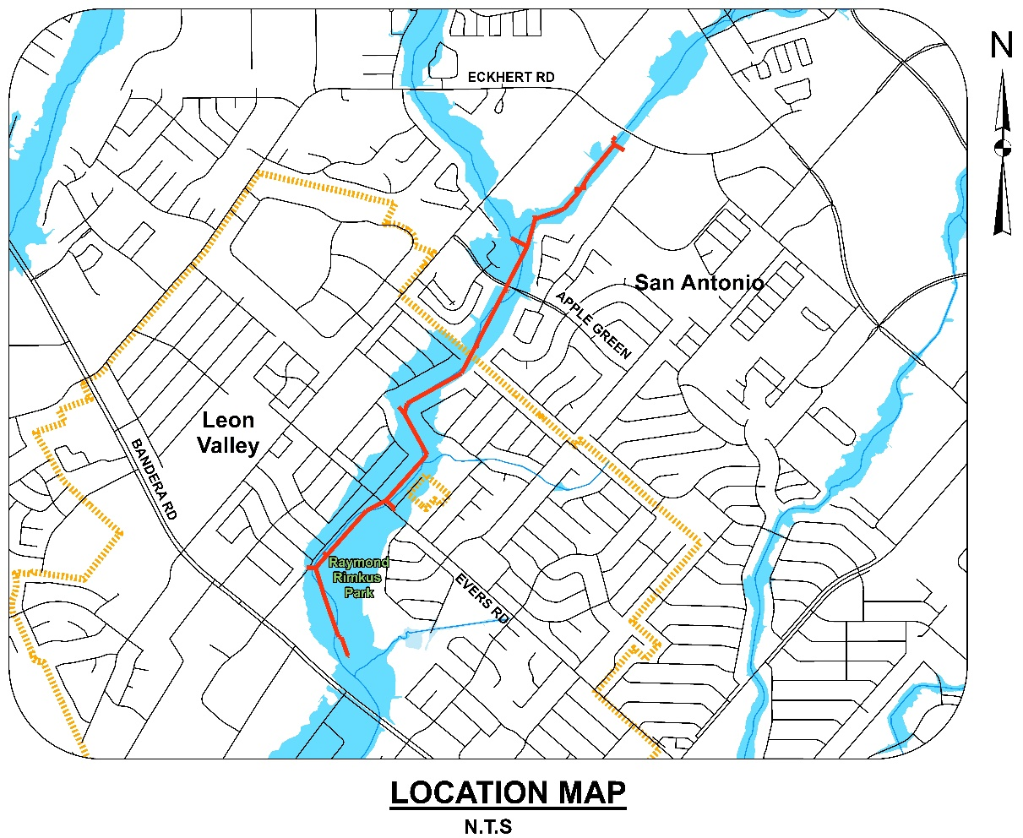
Floodway Construction
The alignment lies entirely within 100-year floodplain; with a substantial portion of the sewer main being installed by open trench within the existing creek bed
The project site is susceptible to quickly rising water from rainfall events
No material shall be stored in the 100-year floodplain longer than the end of the shift in which it was generated

Slide 42
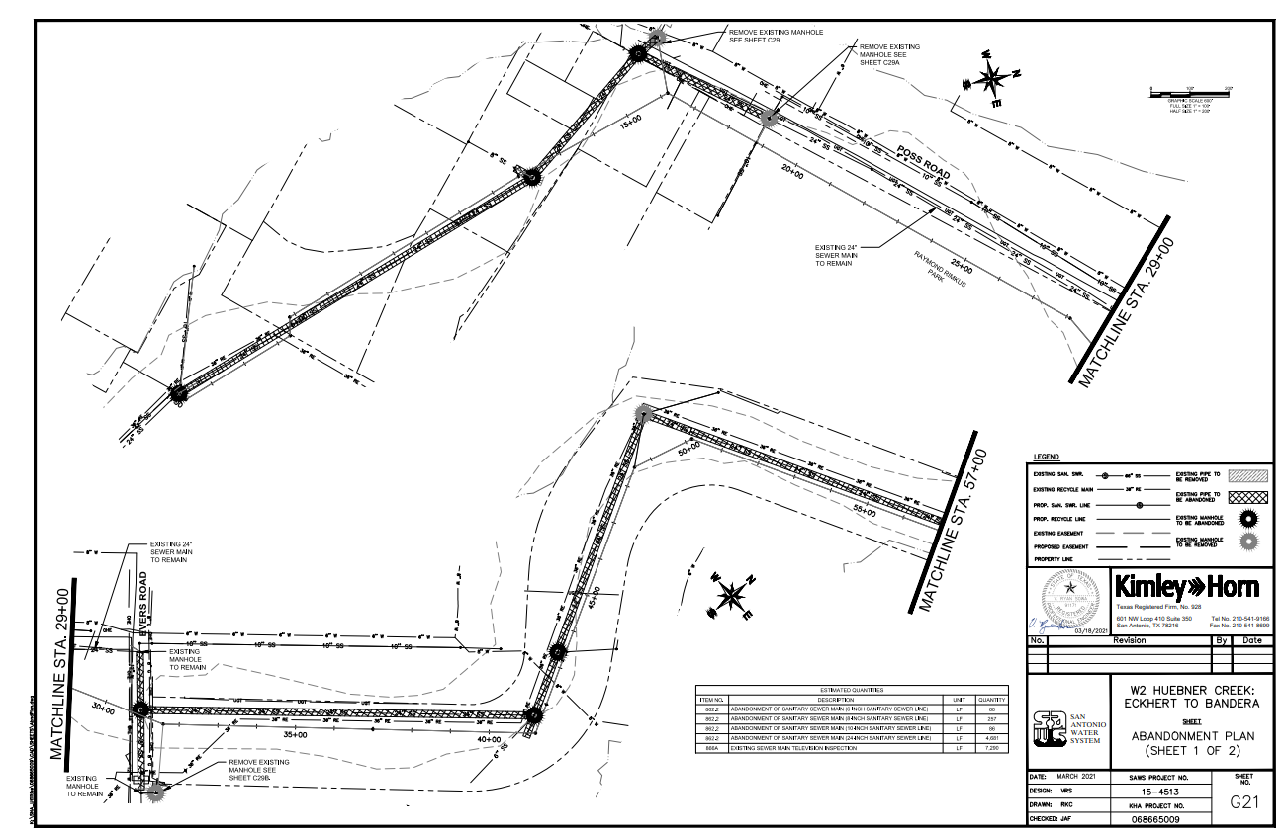
Sewer Abandonment
Abandon-in-Place for majority of 21-inch and 24-inch sewer mains
10,600 LF of sanitary sewer line abandoned
7 manholes being removed

Slide 43
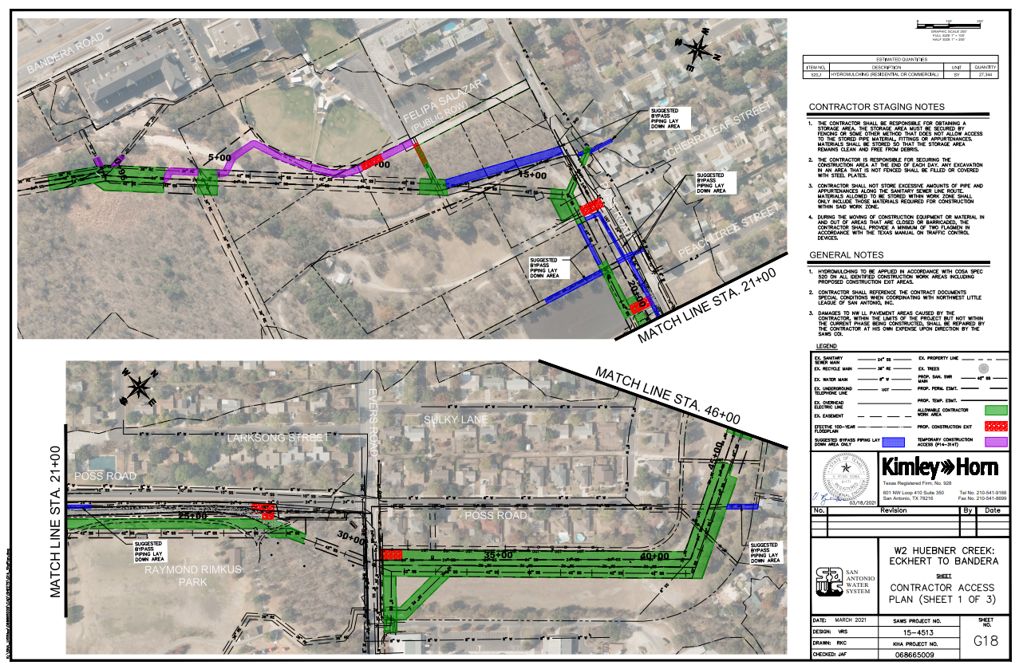
Contractor Access & Work Area Limits
Must maintain local traffic access and safety (including temp signage and barricades).
Restore site upon completion.
Work limited to within temporary and permanent easements as shown on Plans
Temporary access from Northwest Little League of San Antonio, Inc.

Slide 44
Manhole Material Options
Mainline Manholes can be either:
  853A Fiber-Reinforced Sanitary Sewer Manhole; or
  SP850 Polymer Concrete Sanitary Sewer Structure.
Lateral Line Manholes can be either:
  852A Sanitary Sewer Manholes (antimicrobial additive concrete mix); or
  853A Fiber-Reinforced Sanitary Sewer Manhole.

Slide 45
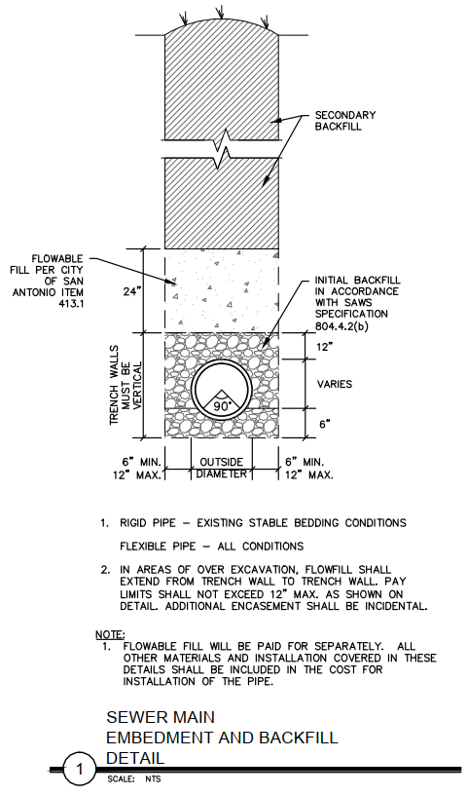
Pipe Bedding and Backfill
All trenched FRP sewer mains and PVC collector sewer mains have a 2 VF cap of Flowable Fill – 150 psi directly above the initial backfill

Slide 46
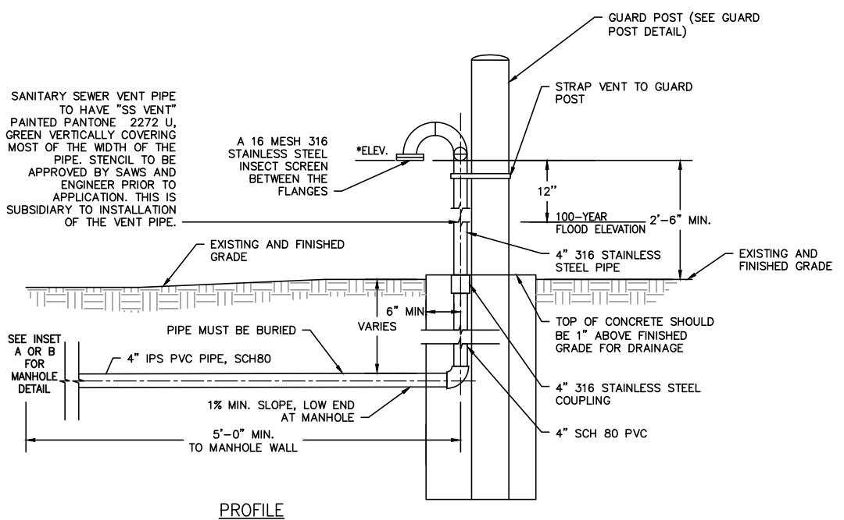
Manhole Venting
Manhole vent lines (7) installed minimum of 1’ above 100-year water surface elevation where shown
Connected to adjacent manholes identified in plans
SEWER MAIN VENTED MANHOLE DETAIL
N.T.S.

Slide 47
Additional Project Details
Easements – Work limited to within areas shown on Plans and per the Supplemental Conditions, T-Posts are to be used by the Contractor to establish easement boundaries
CoSA and CoLV Floodplain Development Permits – Work area subject to periodic inundation
CoSA and CoLV Tree Permits – Pre-construction field meeting with CoSA Arborist and City of Leon Valley Arborist
CoLV Jurisdiction – Additional Coordination

Slide 48
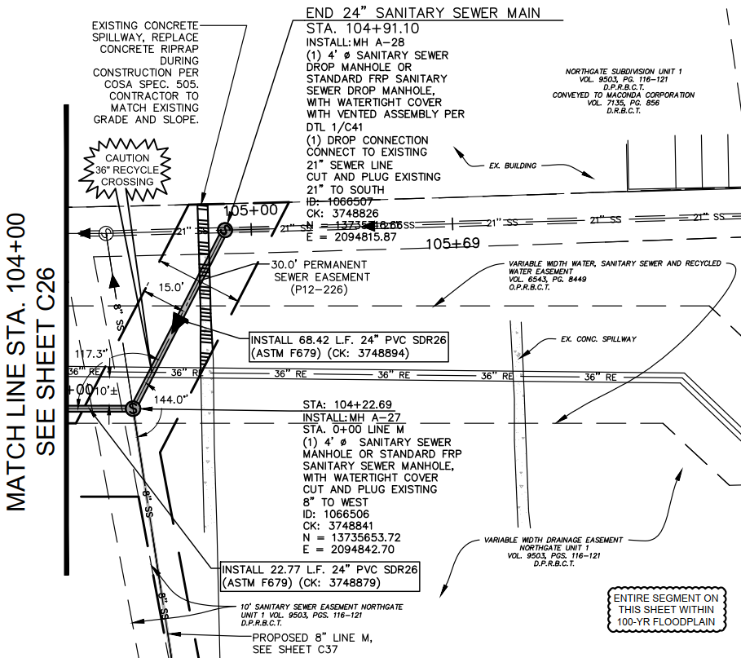
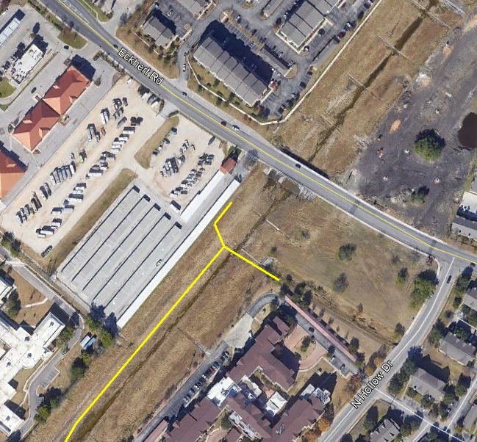

Upstream Tie-In Point

Slide 49
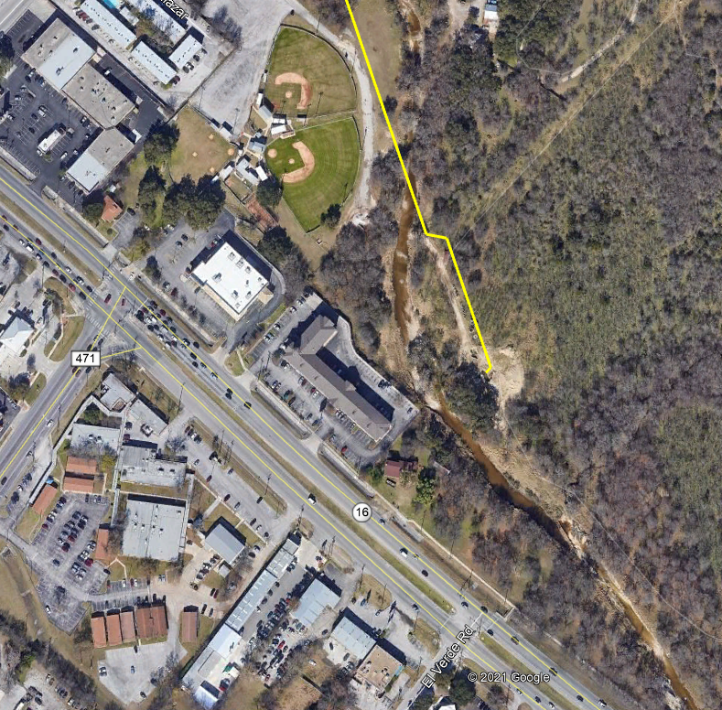
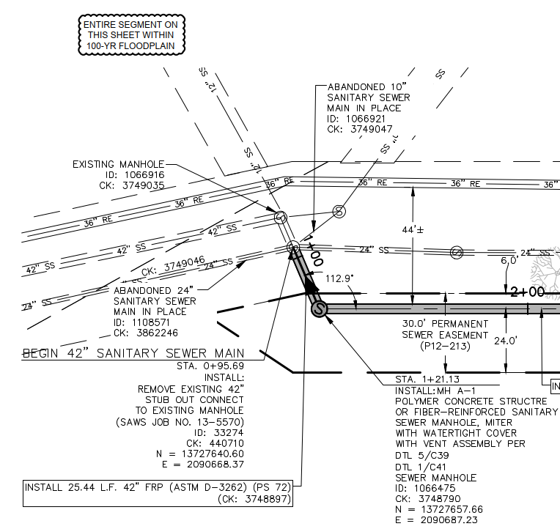

Downstream Tie-in Point

Slide 50
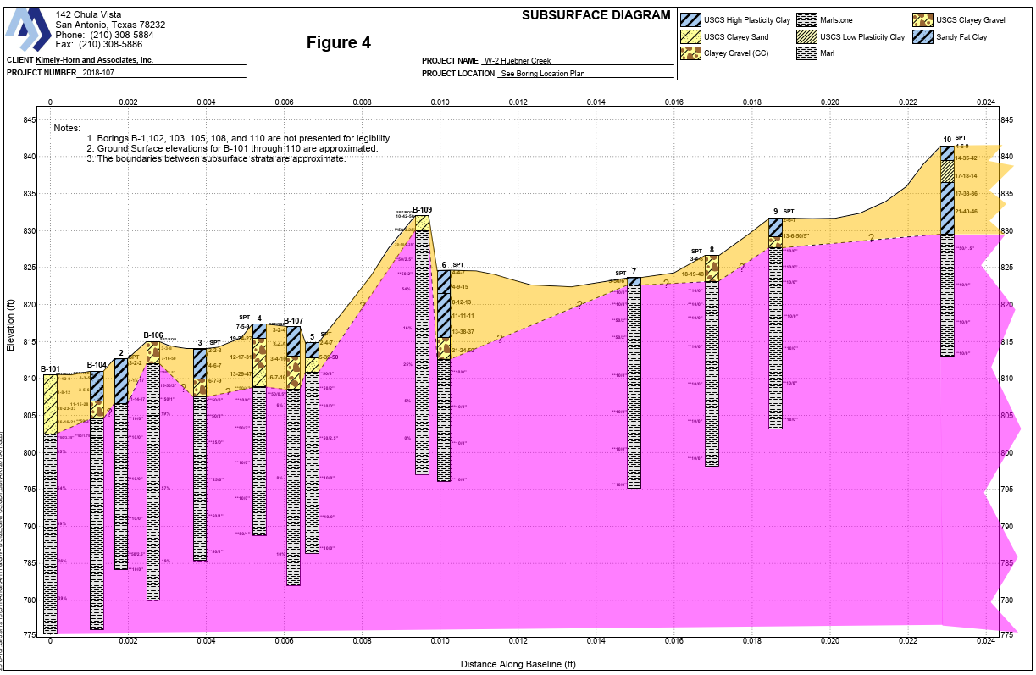
Special Conditions – Rock Excavation
Refer to Special Conditions for requirements
Marlstone was encountered in our borings at relatively shallow depths.
The need for rock excavation equipment should be anticipated for construction at this site.
The additional cost for this work is incidental to pipe installation line items.

Slide 51
Questions
Submitted no later than April 14, 2021 at 4:00 PM CDT
Identify solicitation number
Must be submitted in writing:
  Roxanne L. Lockhart
  Contract Administrator
  Contract Administration Department
  San Antonio Water System
  Roxanne.lockhart@saws.org
  Fax: (210) 233-4438

Slide 52
Questions?
Oral statements or discussion during the pre-proposal meeting will not be binding, nor will it change or affect the terms or conditions within the Plans and Specifications for this Project. Changes, if any, will be addressed only via an Addendum.

Slide 53
W-2: Huebner Creek – Eckhert to Bandera
Patrick O’Connor, PE
Project Engineer, SAWS
Roxanne L. Lockhart
Contract Administrator, SAWS
Marisol V. Robles
SMWVP Program Manager, SAWS
Ryan Sowa, PE
Project Engineer of Record, Kimley-Horn & Associates
Non-Mandatory Pre-Proposal Meeting
April 7, 2021 at 9:30 AM

